Slide 1

Indian Sign Language Character Recognition: A Computer Vision Based System
Ajith.J
Niranjan.M
Saipreethy.M.S
Amrita Vishwa Vidyapeetham, Coimbatore.

Slide 2
Problem Statement What are we trying to do?
Developing a real time system that accepts Indian Sign Language gestures as input through a webcam.
Processing the input using Image Processing techniques.
Outputting the character corresponding to the gesture in text format.

Slide 3
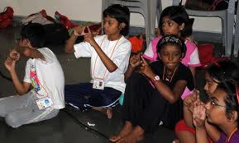
Motivation Why are we doing it?
Hearing and speech impaired people find it very difficult to communicate with others.
5-15 million hearing impaired people in India.
Sign language is very regional as an entity.

Slide 4
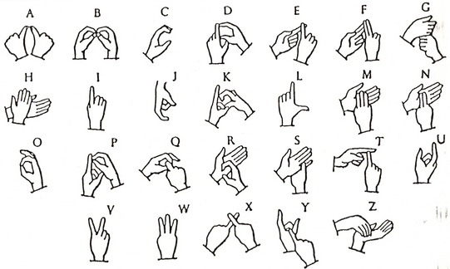
Indian Sign Language Characters

Slide 5
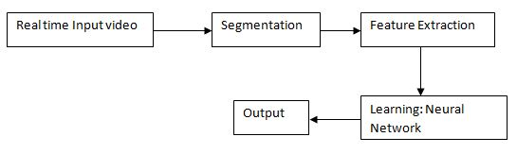
Architecture of the system

Slide 6
Segmentation

Slide 7
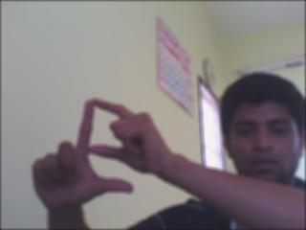
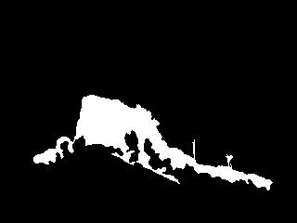
Skin color based segmentation
Hue Saturation and Intensity color model
25<H<230 and 25<S<230
Low complexity.
Very erratic detection.
Influence of brightness persisted.

Slide 8

Motion Based segmentation method
Most of ISL gestures involved some form of motion.
Detection was highly independent of illumination of environment.
But all moving objects in a frame were detected.
Simply assessing the background and subtracting current frame from background

Slide 9


Hybridization
Overlap the outputs of the skin and motion detection and take intersection.
With this illumination invariance and robust detection was achieved.

Slide 10
Feature Extraction

Slide 11
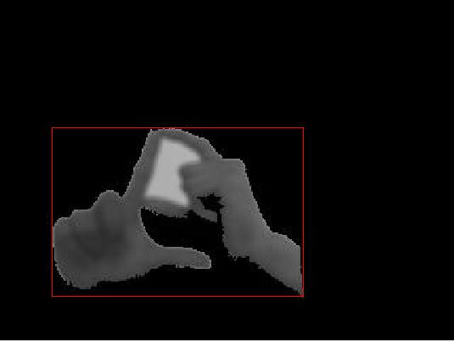
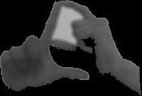
Pre-processing
Need to make sure the features are consistent for the same gesture performed by different people.
Extract the hand region using a bounding box.
Resize image to 90X90 pixels for uniformity.

Slide 12
Histogram of Orientation Gradients
A relatively new technique using primarily for object detection.(2005)
Computes the gradient direction and bins them to form a histogram of n bins.
It is done locally, i.e the image is divided into a number of dense cells and 2 filters are convolved with each cell.
X- gradient: [-1 , 0 , 1 ] and Y gradient: [-1 , 0 , 1]^{T}

Slide 13
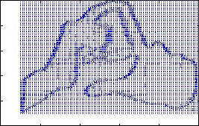
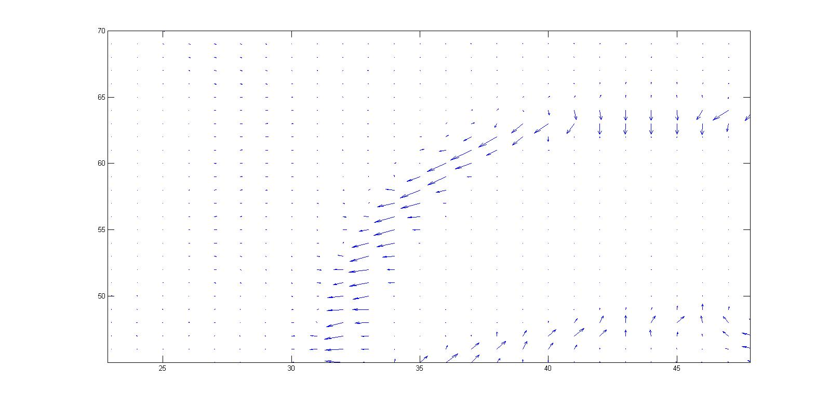
Histogram of Orientation Gradients
Resultant Magnitude:
Sqrt((y-grad)²+(x-grad)²)
Localized normalization of the gradient vectors.

Slide 14
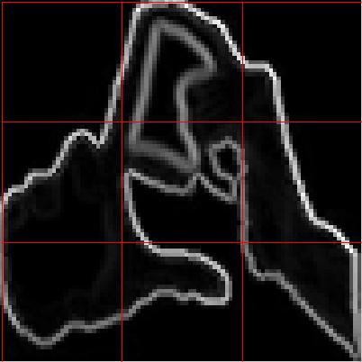

Our parameters
Number of Bins: 12.
Number of cells:3 x 3.
Each cell containing 30x30 pixels.
Final descriptor size: 9x12 unit vector.

Slide 15
Sample Feature Vector
A
B

Slide 16
Neural Network

Slide 17
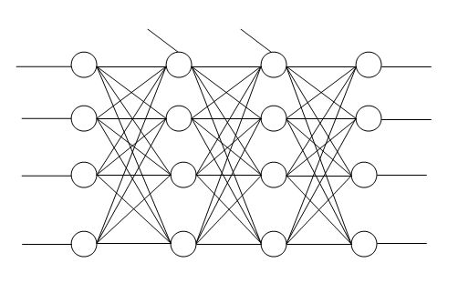
Initial Network Architecture
Hidden layers
Input
Bias 1
Bias 2
Output
1
1
1
1
2
2
2
2
3
3
3
3
108
108
108
21

Slide 18
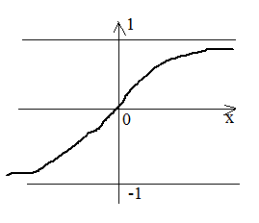
Transfer function- tansig
tansig function is the hyperbolic sigmoid transfer function.
Takes values from -1 to +1

Slide 19

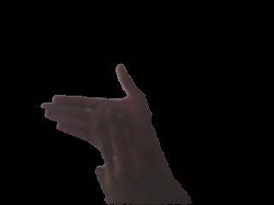

The problem
ISL characters had several ambiguities. Example: m and n, p and d.
When 20 characters where trained and tested using a single network recognition was erratic.

Slide 20
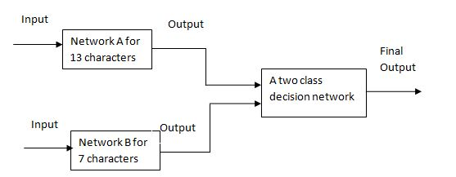
Proposed Network Architecture

Slide 21

Network Details
Two hand: Network A
2 hidden layers
108 input neurons
12output neurons
Two hand: Network B
2 hidden layers
108 input neurons
7 output neurons
Class A: a,b,d,g,h,m,o,p,r,t,x,z
Class B: e,f,k,n,q,s,y

Slide 22
Stopping criteria
Gradient proportional to performance. (gradient is less than 1e-5.)
Number of validation checks=number of successive iterations validation performance fails to decrease.(reaches 6)
Maximum of 100epochs(5 seconds)
Best_epoch:100
best_perf: 0.0087

Slide 23


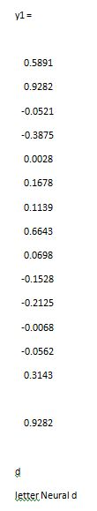
Results
After training the HOG features of the characters

Slide 24
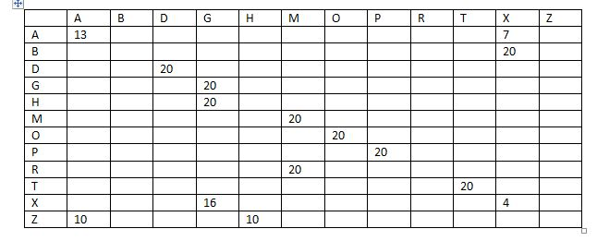
Confusion Matrix
2 handed characters Class A- Magnitude Binning with Thresholding

Slide 25
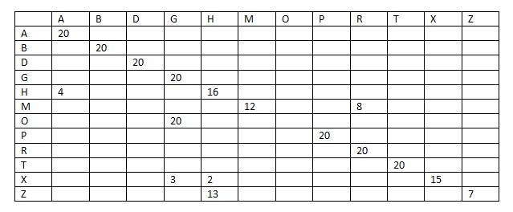
Confusion Matrix
2 handed characters Class A- Magnitude Binning without Thresholding

Slide 26
Confusion Matrix
2 handed characters Class B- Magnitude Binning without Thresholding
 | E | F | K | N | Q | S | Y
E | 20
F | 2 | 18
K |  | 2 | 18
N |  | 2 |  | 18
Q |  | 5 |  |  | 15
S |  |  |  |  |  | 20
Y |  |  |  |  |  |  | 20

Slide 27
Conclusion
We still have to do extensive testing with several people.
Identification of optimal features(bins).
ISL has a vast vocabulary that includes gestures for almost 3000 words.
These words involves more than just hands.

Slide 28
Thank You.

